Slide 1
Smart Proctoring
Project By :- Exam Seat no :- Div :-
Abhishek Patil 4334 B

Slide 2
Introduction :-
In today's digital era, the rise of online education has revolutionized the way students learn and are assessed. However, this shift to virtual learning environments has also raised concerns about maintaining the integrity of assessments conducted remotely. Smart proctoring systems emerge as a response to these challenges, offering a comprehensive solution to ensure the credibility and validity of online exams. These systems integrate a range of functionalities aimed at verifying the identity of test-takers, monitoring their behavior during exams, and detecting any signs of cheating or academic misconduct.
At the heart of smart proctoring systems lies a sophisticated blend of technologies designed to enhance exam security and integrity. Biometric authentication methods, such as facial recognition or fingerprint scanning, are employed to verify the identity of the test-taker before the exam begins. Once the exam is underway, real-time video surveillance and AI-driven algorithms analyze various parameters, including facial expressions, eye movements, and keyboard inputs, to detect any suspicious behaviors indicative of cheating. Additionally, these systems monitor the content of the exam itself, as well as any external resources accessed during the test, using automated plagiarism detection algorithms to identify instances of academic dishonesty.
The adoption of smart proctoring systems offers numerous benefits for educational institutions, instructors, and students alike. By providing robust monitoring and detection capabilities, these systems help safeguard the integrity of online assessments, preserving the credibility of academic credentials. Moreover, smart proctoring systems promote fairness and equity in the evaluation process by ensuring that all students are subject to the same level of scrutiny and monitoring during exams.

Slide 3
Existing System :-
Remote Proctoring via Webcam:
Early method for online exam monitoring.
Students take exams from their own computers while being recorded via webcam.
Proctors or invigilators review video footage afterward to ensure compliance with exam rules and detect suspicious behaviors.
Limitations of Traditional Methods:
Effectiveness: Traditional methods have limitations in detecting all forms of cheating.
Scalability: Reviewing footage and real-time monitoring can be resource-intensive.
Adaptability: These methods may not adapt well to evolving cheating techniques.
Screen Sharing Tools:
Allows proctors to view the test-taker's computer screen in real-time during the exam.
Enables proctors to monitor the test-taking process and intervene if any unauthorized activities are detected.

Slide 4
Need For System :-
Ensuring Exam Integrity:
Cheating Prevention: AI systems can detect and prevent various forms of cheating, ensuring a fair testing environment.
Real-Time Monitoring: Continuous surveillance and real-time alerts for suspicious behaviors maintain the integrity of the examination process.
Scalability:
Efficient Resource Utilization: AI can handle large volumes of test-takers simultaneously, reducing the need for extensive human proctoring resources.
Global Accessibility: Allows institutions to conduct exams for candidates worldwide without geographical limitations.
Cost-Effectiveness:
Reduced Operational Costs: Automation reduces the need for physical exam centers and human proctors, lowering overall examination costs.
Time Efficiency: Quick setup and automated processes save time for both administrators and students.

Slide 5
Proposed System :-
Real-time Video Surveillance: The system utilizes webcams to monitor test-takers in real-time during exams, capturing video feeds of their face and surroundings. AI algorithms analyze the video footage to detect suspicious behaviors, such as looking away from the screen, talking to someone off-camera, or using unauthorized materials.
Behavior Analysis: AI-powered behavior analysis algorithms examine various aspects of the test-taker's behavior, including eye movements, keyboard inputs, and mouse clicks. These algorithms detect patterns indicative of cheating and flag suspicious behaviors for further review.
Biometric Authentication: Before the exam begins, the system verifies the identity of the test-taker using biometric authentication methods such as facial recognition or fingerprint scanning. This ensures that the person taking the exam is indeed the registered student and not an imposter.
Secure Browser Mode: To prevent unauthorized access to external websites, applications, or communication platforms during the exam, the system employs secure browser modes. These modes restrict the test-taker's access to other tabs, windows, or software on their computer, minimizing the risk of cheating through unauthorized resources.

Slide 6
Objective of System :-
Ensure Exam Integrity: The primary objective of a smart proctoring system is to ensure the integrity and credibility of online exams. By monitoring test-takers in real-time and detecting suspicious behaviors, the system aims to prevent cheating, academic dishonesty, and unauthorized access to exam materials.
Promote Academic Fairness and Equity: The system seeks to promote fairness and equity in the evaluation process by providing consistent monitoring and supervision for all students, regardless of their location or circumstances. This helps ensure that all students have an equal opportunity to demonstrate their knowledge and abilities during exams.
Enhance Exam Security: By employing advanced technologies such as AI, machine learning, and biometric authentication, the system aims to enhance the security of online exams and protect against cheating tactics such as plagiarism, collusion, and unauthorized assistance.
Provide Flexibility and Accessibility: A key objective of the system is to provide flexibility and accessibility for students to take exams remotely, without the need to travel to physical testing centers. This accommodates the diverse needs and preferences of learners, including those with disabilities or other accessibility needs.
Streamline Exam Administration: The system aims to streamline the administration of online exams for instructors and administrators by automating monitoring processes, reducing manual intervention, and providing efficient tools for exam setup, scheduling, and management.

Slide 7
Scope of work :-
Feature Set: The scope of smart proctoring systems encompasses a wide range of features designed to ensure the integrity of online exams. These features may include identity verification, real-time video surveillance, behavior analysis, content monitoring, browser lockdown, and plagiarism detection, among others.
Integration with Learning Management Systems (LMS): Smart proctoring systems often integrate seamlessly with existing learning management systems (LMS) used by educational institutions. This integration allows for streamlined exam administration, automatic data transfer, and centralized management of exam settings and monitoring parameters.
Scalability and Flexibility: Smart proctoring systems should be scalable to accommodate exams of varying sizes and formats, from small quizzes to large-scale assessments. They should also be flexible enough to adapt to different exam formats, including multiple-choice questions, essays, and practical assessments across various subject areas.
Compliance and Security: Smart proctoring systems must adhere to relevant privacy regulations and security standards to protect the integrity of exam data and ensure compliance with institutional policies. This includes measures to safeguard sensitive information, encrypt data transmissions, and prevent unauthorized access to exam materials.

Slide 8
Module Specification :-
Authentication Management
Admin Management
Student Management
Exam Management
Course Management
Proctoring Management
Result Management

Slide 9
Operating Environment-Hardware and Software :-
Hardware Specification:
Desktop/Laptop
Hard Disk 512GB or more
RAM 4GB or more
Processor intel core i3 11gen
Software Specification:
Windows 10 or above
Visual studio /PyCharm

Slide 10
Technology used :-
HTML (Hypertext Markup Language): HTML is the standard markup language used to create and structure web pages. It provides a set of tags and elements that define the content and layout of a web page, including headings, paragraphs, links, images, and forms.
CSS (Cascading Style Sheets): CSS is a stylesheet language used to control the presentation and styling of HTML elements on a web page. It allows developers to specify properties such as colors, fonts, margins, padding, and positioning, helping to create visually appealing and consistent designs across different devices and browsers.
SQLite: SQLite is a lightweight, serverless relational database management system (RDBMS) that is embedded within applications. It is widely used for storing and managing structured data in a local or embedded context, offering features such as ACID transactions, SQL query support, and cross-platform compatibility.
Python: Python is a high-level, interpreted programming language known for its simplicity, readability, and versatility. It is widely used for various purposes, including web development, data analysis, artificial intelligence, machine learning, automation, and scripting. Python's extensive standard library and rich ecosystem of third-party packages make it a popular choice among developers.

Slide 11
Technology used :-
JavaScript: JavaScript is a programming language commonly used for client-side web development. It enables dynamic and interactive functionality on web pages, such as form validation, DOM manipulation, event handling, and asynchronous communication with servers. JavaScript is supported by all modern web browsers and is essential for building responsive and engaging web applications.
Windows 10: Windows 10 is a widely used operating system developed by Microsoft. It provides a user-friendly interface, robust security features, and support for a wide range of hardware and software applications. Windows 10 includes features such as the Start menu, Taskbar, Cortana virtual assistant, Microsoft Edge web browser, and integration with other Microsoft services such as Office 365.
TOOLS :
PyCharm IDE
MySQL Workbench

Slide 12
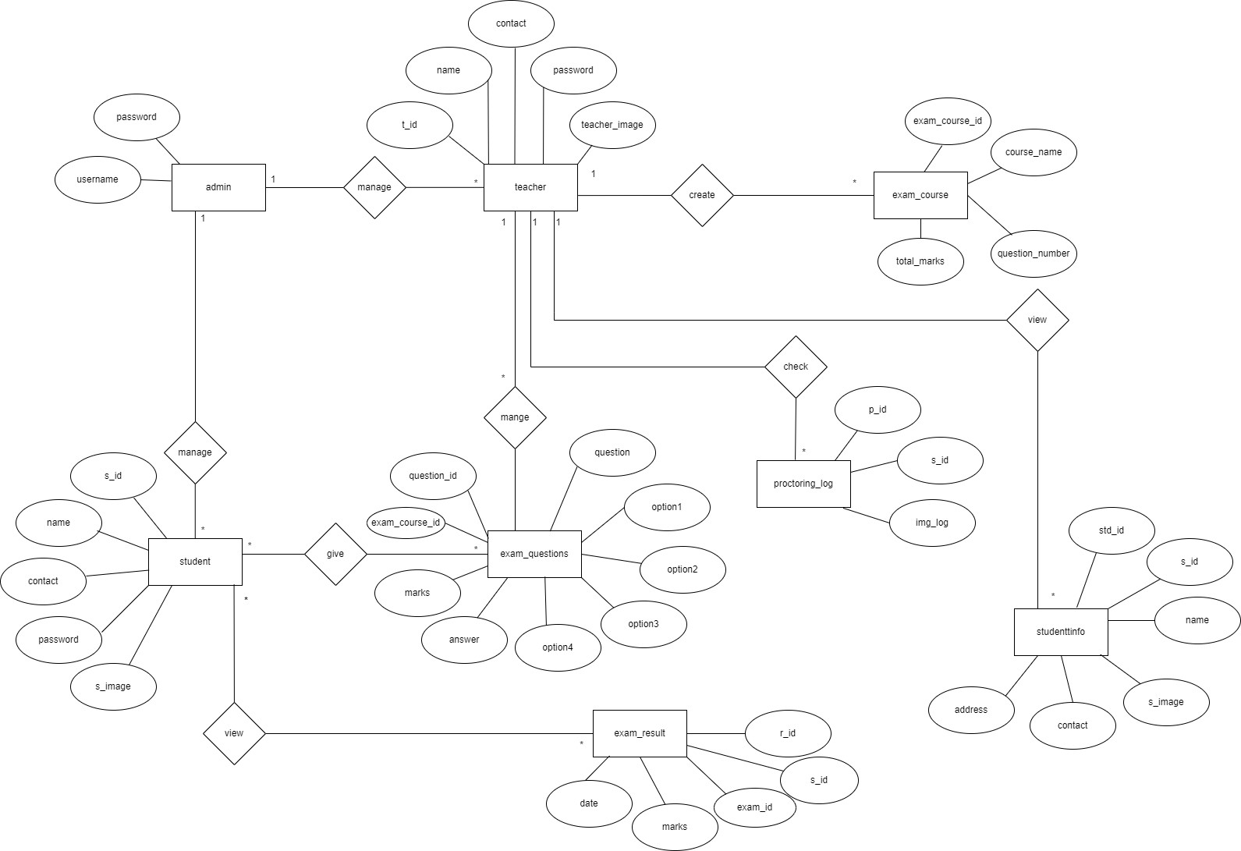
Analysis & Design :-
ER Diagram :

Slide 13
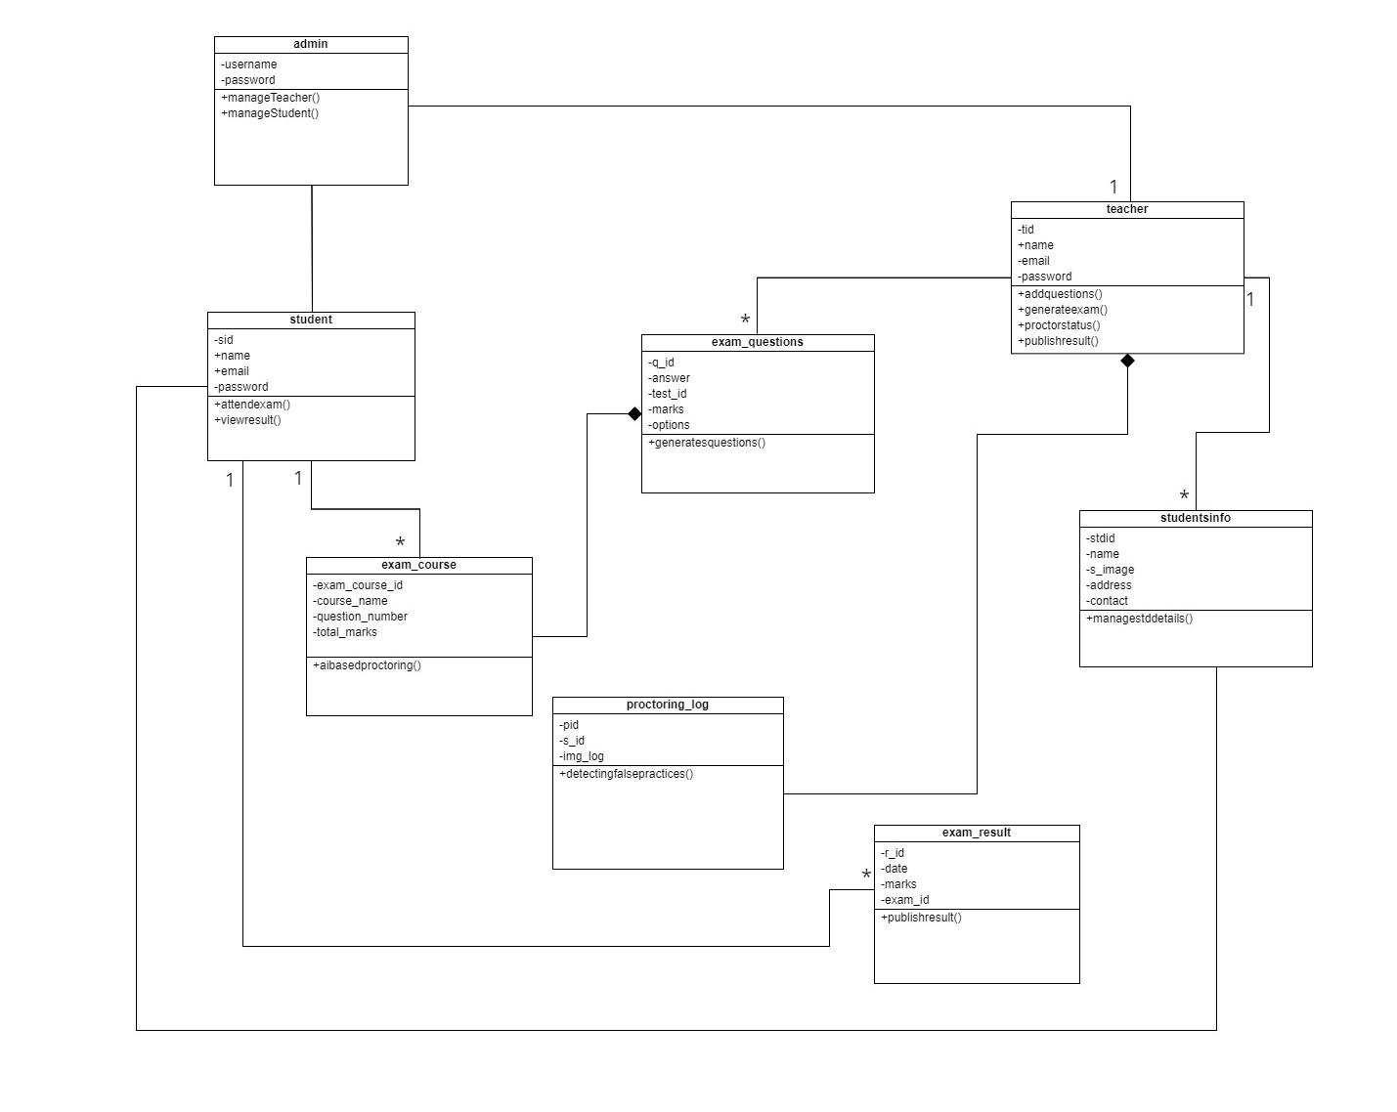
Class Diagram :

Slide 14
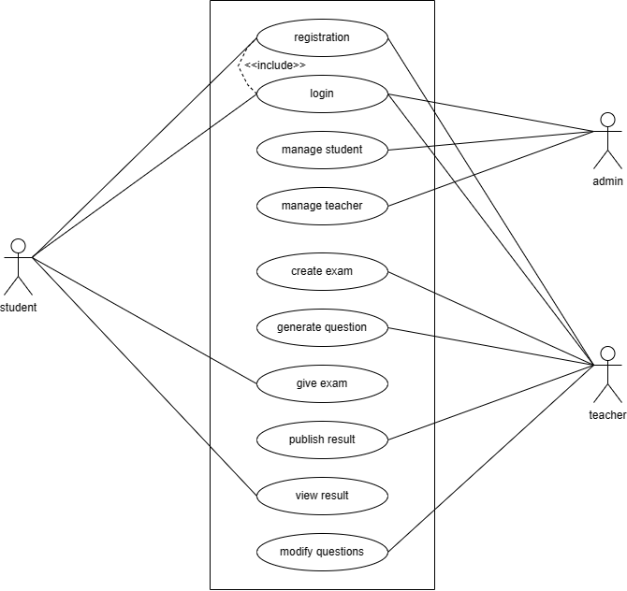
Use Case Diagram :

Slide 15
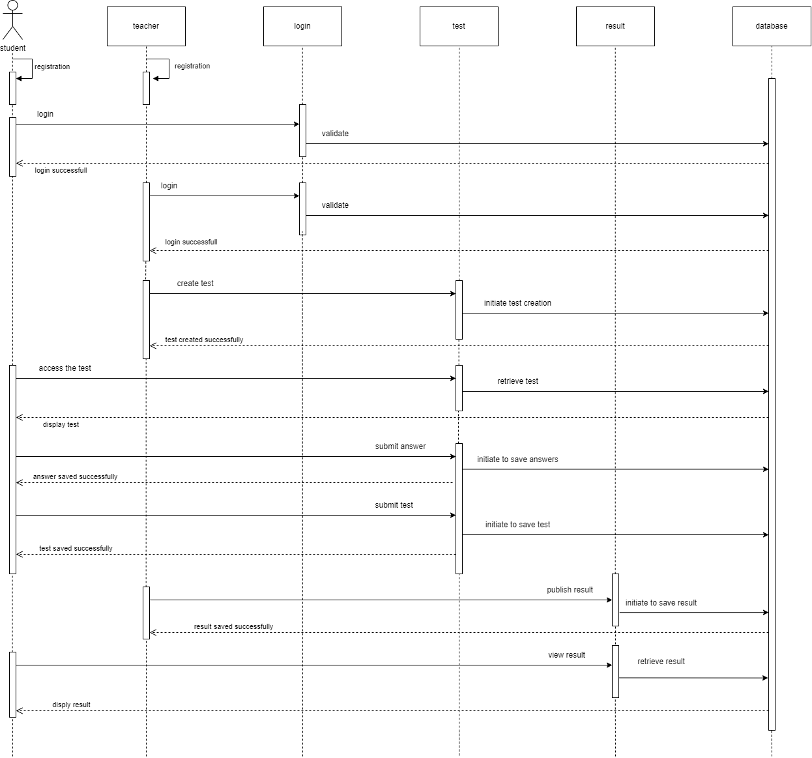
Sequence Diagram :

Slide 16
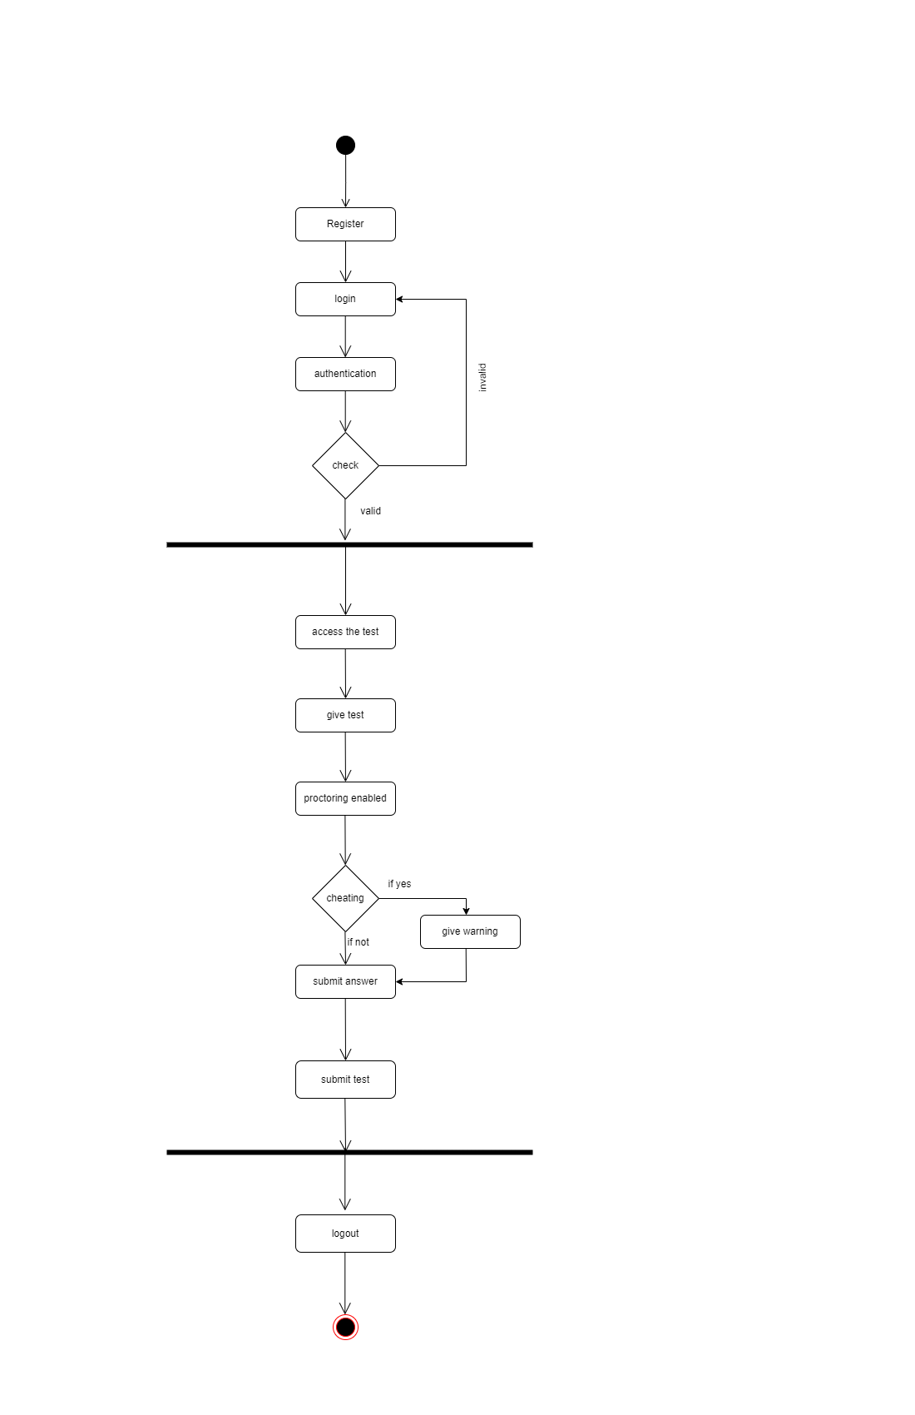
Activity Diagram:
Student Activity Diagram :

Slide 17
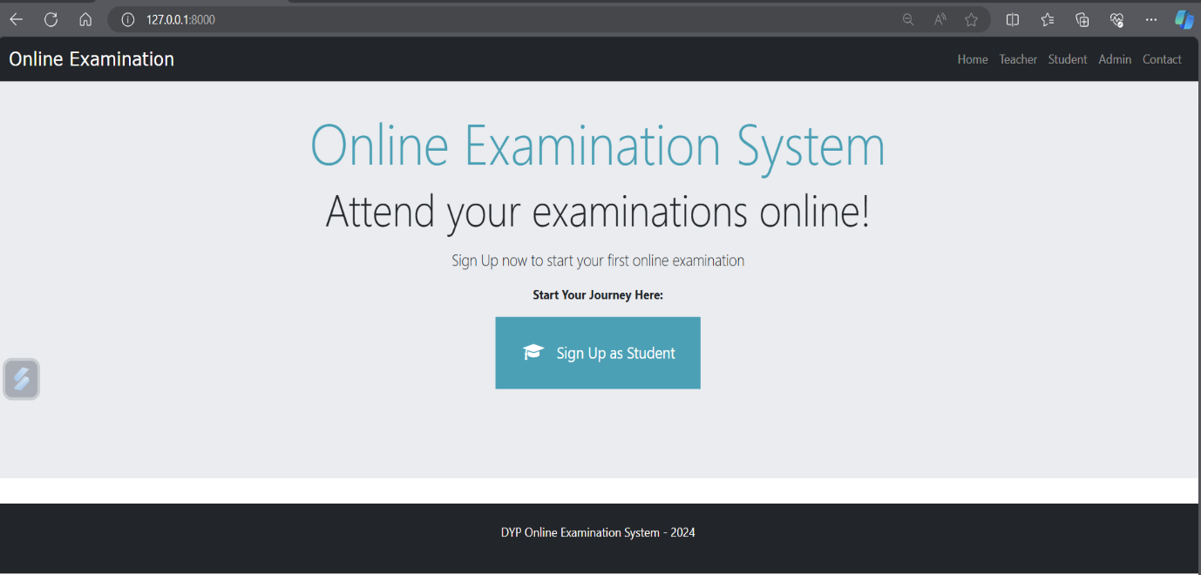
User Interface Design
Homepage screen:

Slide 18
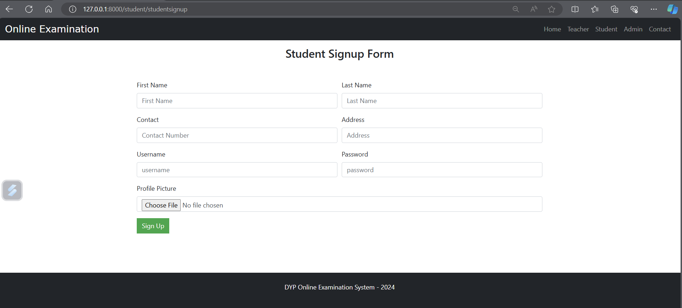
Student Signup Screen :

Slide 19
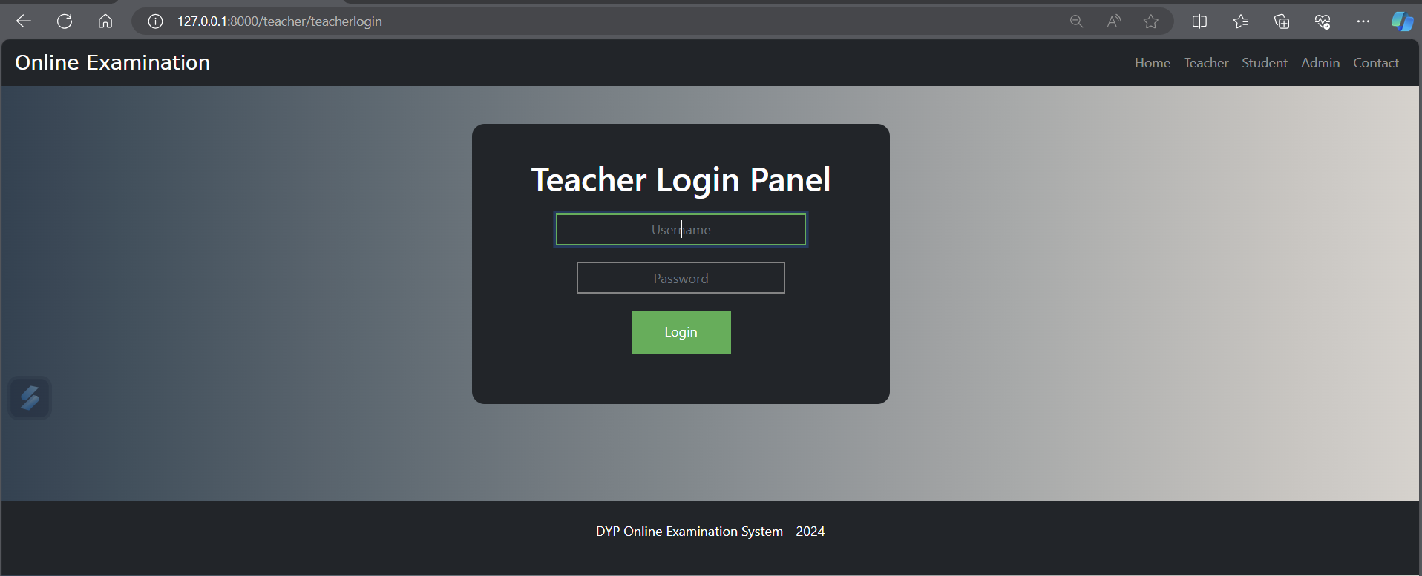
Teacher login screen:

Slide 20
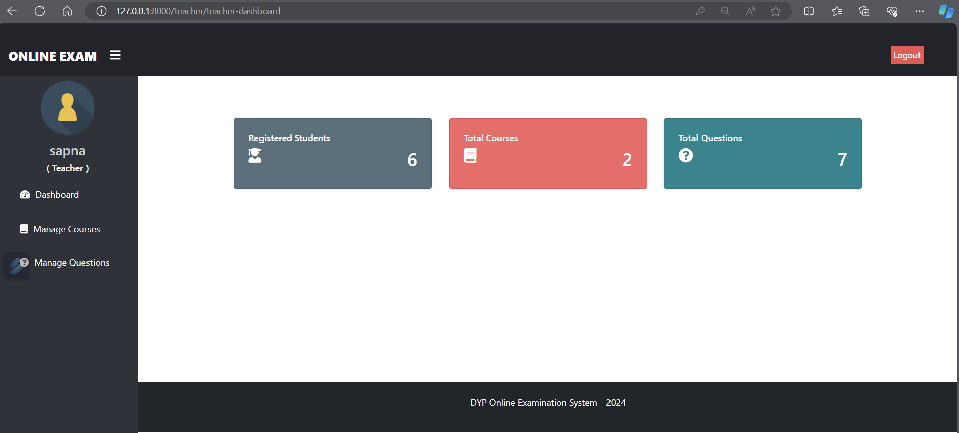
Teacher dashboard screen:

Slide 21
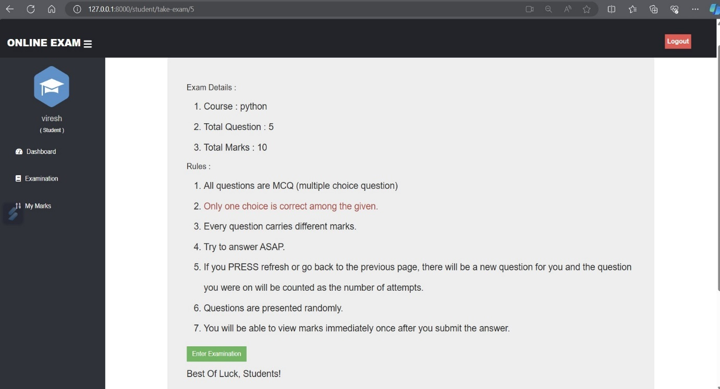
Student exam dashboard screen:

Slide 22
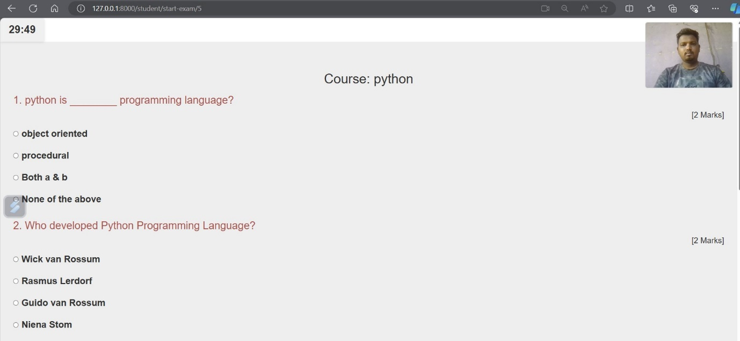
Student exam screen:

Slide 23
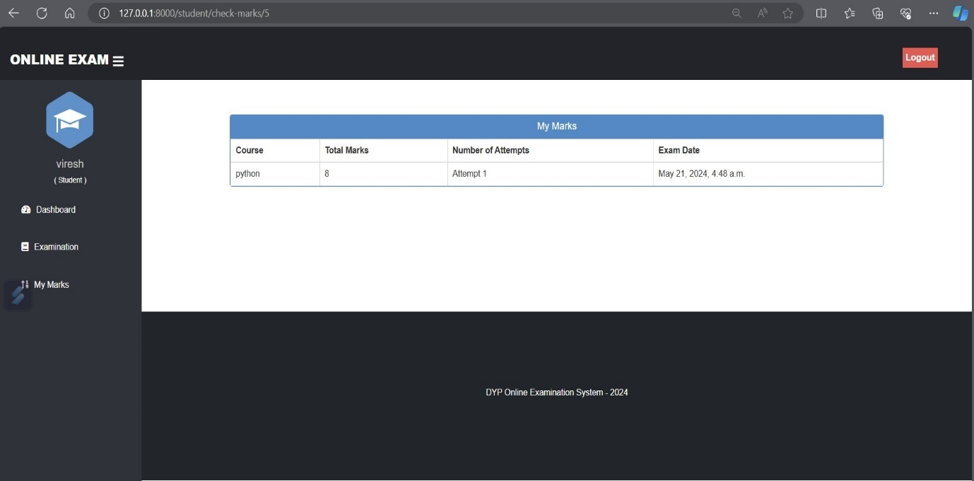
Student marks screen:

Slide 24
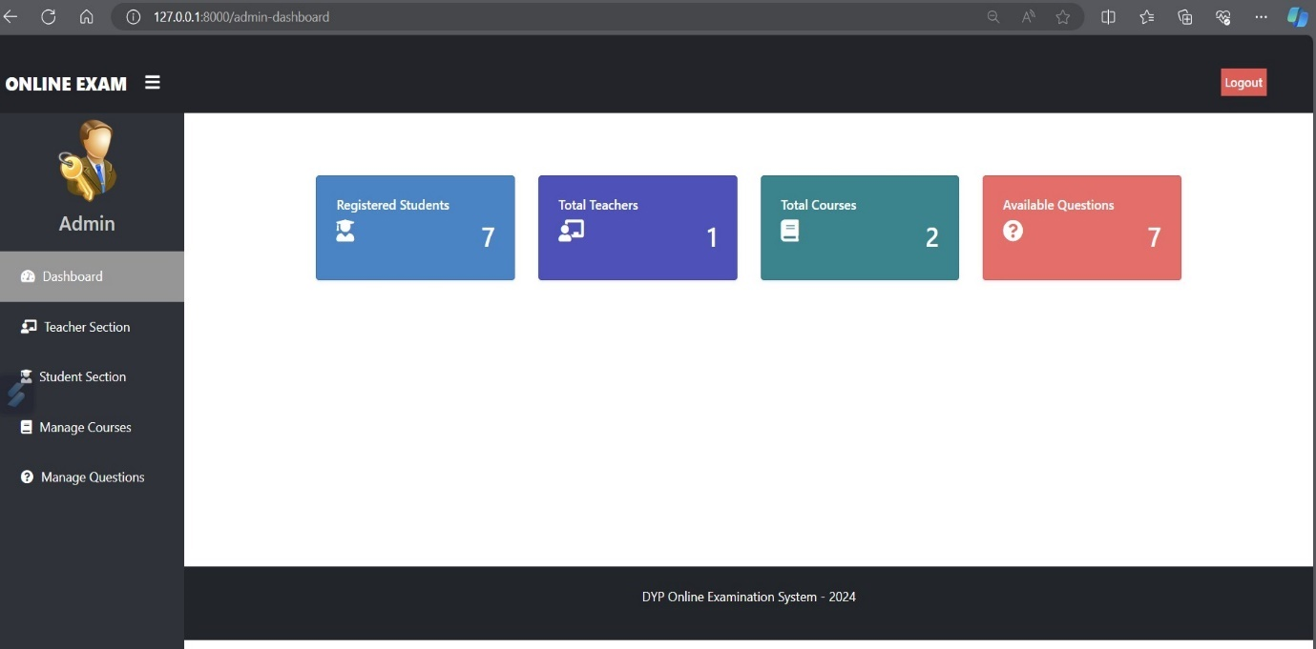
Admin dashboard screen:

Slide 25
Data Dictionary :-
Table Structure :
Admin table:
Student table :
Field Name | Data Type | Description | Constraint
username | Varchar (20) | Admin email id | not null
password | varchar (20) | Admin password | not null
Field Name | Data Type | Description | Constraint
s_id | Int | Student id | primary key, auto_increment, not null
name | varchar (20) | Student name | not null
s_image | blob | Student image | not nulele
email | varchar (50) | Student mail id | not null
password | varchar (30) | Password of student | not null

Slide 26
Teacher table:
exam_questions table:
Field Name | Data Type | Description | Constraint
t_id | Int | Teacher id | primary key, auto_increment, not null
name | varchar (20) | Teacher full name | not null
teacher_image | blob | Teacher image | not null
contact | varchar (50) | Teacher contact info | not null
password | varchar (30) | Password of teacher | not null
Field Name | Data Type | Description | Constraint
question_id | Int | Question id | primary key, auto_increment, not null
exam_course_id | Int | Exam Course id | foreign_key
question | Bigint | Input question | not null
option1 | varchar (50) | Option 1 | not null
option2 | varchar (30) | Option 2 | not null
option3 | varchar (30) | Option 3 | not null
option4 | varchar (30) | Option 4 | not null
ans | varchar (30) | Answer for question | not null
marks | varchar (30) | Marks for answer | not null

Slide 27
exam_course table :
proctoring_log table :
exam_result table :
Field Name | Data Type | Description | Constraint
exam_course_id | Int | Exam id | primary key, auto_increment, not null
course_name | varchar | Course name | not null
question_number | Int | Question number | not null
total_marks | Int | Marks obtained for exam | not null
Field Name | Data Type | Description | Constraint
p_id | Int | Proctoring id | primary key, auto_increment, not null
s_id_ | Int | Student id | foreign_key
img_log | varchar (50) | Student image logs | not null
Field Name | Data Type | Description | Constraint
r_id | Int | Result id | primary key, auto_increment, not null
exam_id | Int | Exam id | foreign_key
marks | Bigint | Marks | unique
s_id | varchar (50) | Student id | foreign key
date | Int | Date and time of the exam | not null

Slide 28
Drawbacks & Limitations :-
Drawbacks :
Privacy Concerns
Potential misuse of biometric data (e.g., facial recognition).
Concerns over the extensive monitoring and data collection.
Technical Issues
Dependency on stable internet connections for real-time monitoring.
Possible technical glitches or system downtimes affecting exams.
High Initial Costs
Significant investment required for developing and implementing AI technologies.
Ongoing maintenance and update costs.
Accessibility Challenges
Difficulties in making the system fully accessible for all users, especially those with severe disabilities.
Potential issues with adapting to diverse technological infrastructures across regions.

Slide 29
Limitations :
Technology Constraints:
Accuracy: AI algorithms may not always accurately detect cheating behaviors or identify suspicious activities, leading to false positives or false negatives.
Resource Intensive: AI algorithms for proctoring and grading can be computationally intensive, requiring substantial processing power and memory resources.
Privacy Concerns:
Data Privacy: AI-based proctoring systems may capture and analyze sensitive data, including video feeds and biometric information, raising privacy concerns among students and instructors.
Consent and Transparency: Users may feel uncomfortable with the level of surveillance imposed by AI proctoring systems, leading to issues of consent and transparency regarding data collection and usage.
Technical Limitations:
Complexity: AI-based systems require specialized expertise in machine learning, computer vision, and natural language processing, which may pose challenges for implementation, maintenance, and troubleshooting.
Robustness: AI algorithms may struggle to adapt to novel or unexpected scenarios, leading to errors or inaccuracies in detection and decision-making.

Slide 30
Proposed System:
Enhanced Proctoring Features:
AI-Powered Monitoring: Implement advanced AI algorithms for real-time monitoring of examination sessions to detect suspicious behaviors such as cheating, impersonation, or unauthorized access.
Behavior Analysis: Utilize AI models to analyze student behavior patterns, eye movements, keyboard strokes, and facial expressions to identify anomalies and flag potential violations.
Intelligent Alerts: Incorporate intelligent alerting mechanisms to notify proctors or administrators of detected anomalies, enabling timely intervention and investigation.
Fairness and Bias Mitigation:
Bias Detection and Mitigation: Implement mechanisms to identify and mitigate biases in AI algorithms used for grading and proctoring, ensuring fairness and equity in assessment outcomes across diverse student populations.
Ethical AI Guidelines: Adhere to ethical AI principles and guidelines, including transparency, accountability, fairness, and privacy protection, to uphold students' rights and promote trust in the system.

Slide 31
Privacy-Enhanced Design:
Privacy-Preserving Technologies: Employ privacy-enhancing technologies such as differential privacy, federated learning, and encrypted computation to protect sensitive student data and preserve privacy during examination sessions and data processing.
User Consent and Transparency: Ensure transparent communication with users regarding data collection, usage, and retention practices, and provide mechanisms for obtaining informed consent and exercising data privacy rights.
Robustness and Reliability:
Robust AI Models: Develop and train robust AI models capable of handling diverse scenarios, input variations, and edge cases encountered during examination sessions, minimizing errors and false alarms.
Fault Tolerance: Implement fault-tolerant design principles and redundancy measures to ensure system resilience and availability, even in the face of hardware failures, network disruptions, or unexpected events.

Slide 32
Thank You ..

